Slide 1
Classification
Organizing the Diversity of Life

Slide 2
Why do we classify things?
  Supermarket aisles
  Libraries
  Classes
  Teams/sports
  Members of a family
  Roads
  Cities
  Money

Slide 3
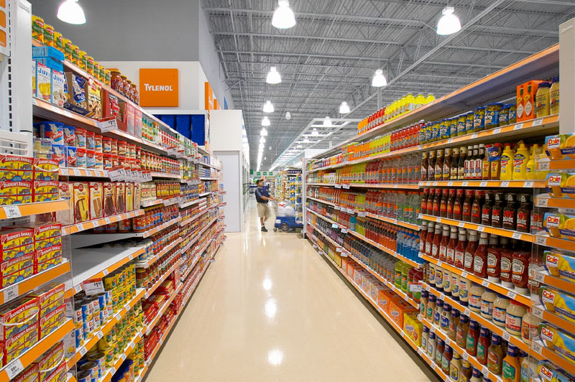
Classification
The grouping of objects or information based on similarities

Slide 4
Taxonomy
Branch of biology dealing with the identification, classification, and nomenclature of organisms.

Slide 5
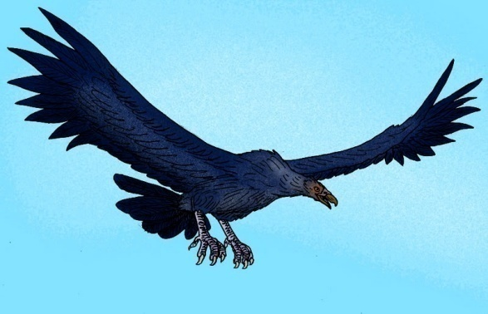
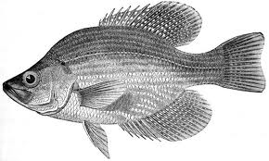
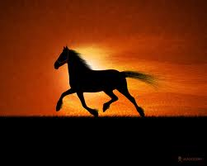
Early classification systems
Aristotle grouped animals according to the way they moved
What would be a problem with this?

Slide 6
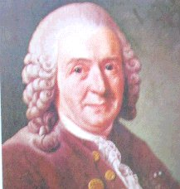
Classification based on physical and structural similarities
Carolus Linnaeus (1707-1778)
Created binomial nomenclature (2 word naming system)
1st word = Genus (genera if plural) = a group of similar species
2nd word = Species
Scientific name = Genus + Species e.g. Homo sapiens

Slide 7
The modern classification system :
Developed by Carolus Linnaeus
Consists of 7 levels:
Kingdom
Phylum
Class
Order
Family
Genus
Species

Slide 8
Taxonomic Rankings
Kingdom King
Phylum Phillip
Class Came
Order Over
Family For
Genus Good
Species Spaghetti

Slide 10
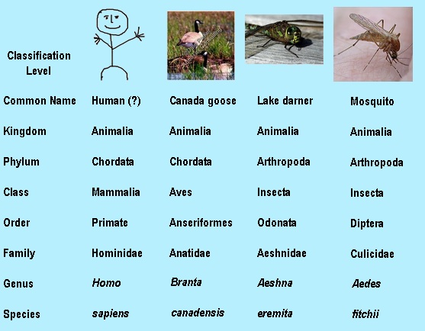

Slide 11
Modern Taxonomy Evidence
The Evidence used to classify into taxon groups
  1) Embryology
  2) Chromosomes / DNA
  3) Biochemistry
  4) Physiology
  5) Evolution
  6) Behavior

Slide 12
DNA
Taxonomists use comparisons of macromolecules such as DNA, RNA, and proteins as a kind of “molecular clock”.
Scientists compare amino acid sequences for homologous protein molecules of different species.
The number of amino acid differences a clue to how long ago two species diverged from a shared evolutionary ancestor.

Slide 13
The genes of many organisms show important similarities at the molecular level.
Similarities in DNA can be used to help determine classification and evolutionary relationships.
The more similar the DNA sequences of two species, the more recently they shared a common ancestor, and the more closely they are related in evolutionary terms.

Slide 14
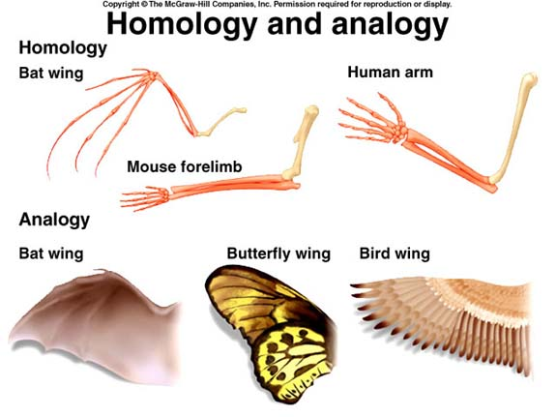
Morphology
Taxonomists study an organism’s morphology and compare it to other living organisms.
  Homologous features are important but it is important to separate features that are truly homologous with those the seem homologous but are actually analogous.
  The more homologous features two organisms share, the more closely related they are thought to be.

Slide 15
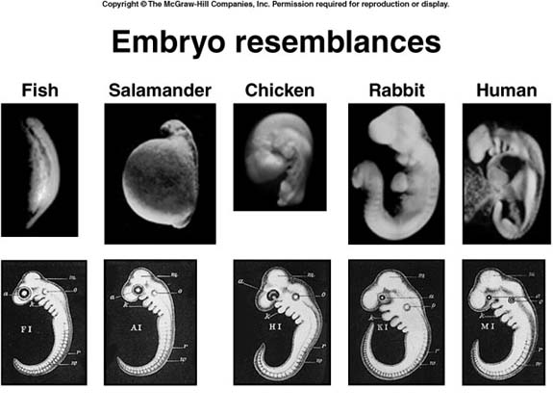
Embryological Patterns of Development
Early pattern in embryological development provide evidence of phylogenetic relationships.
They also provide means of testing hypotheses about relationships that have developed from other lines of evidence

Slide 16
Evolutionary Classification
evolutionary classification = method of grouping organisms together according to their evolutionary history
Phylogeny = the study of evolutionary relationships among organisms
Biologists now group organisms into categories that represent lines of evolutionary descent, or phylogeny, not just physical similarities.

Slide 17
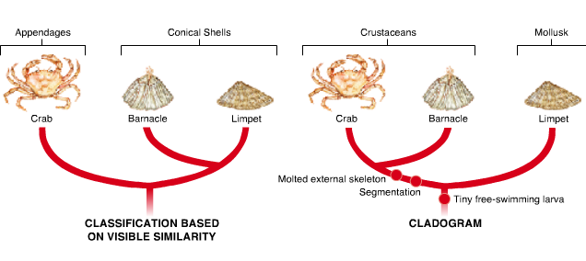

Slide 18
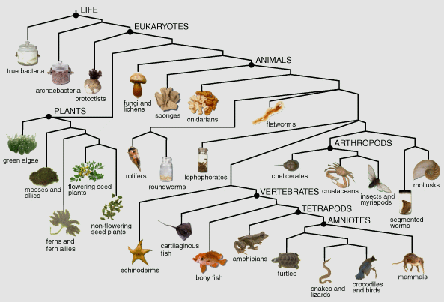
Cladogram = diagram that shows the evolutionary relationships among a group of organisms

Slide 19
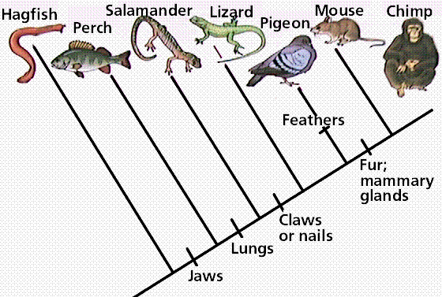

Slide 20
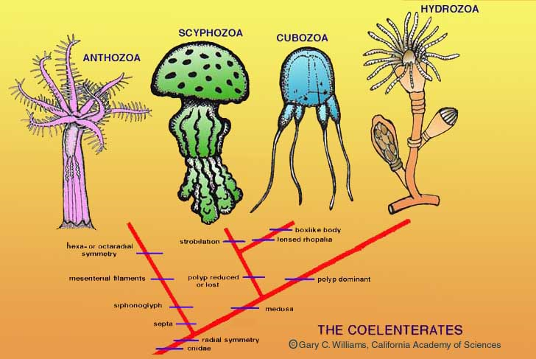

Slide 21
Dichotomous Key
A dichotomous key is a tool that allows the user to determine the identity of items in the natural world, such as trees, wildflowers, mammals, reptiles, rocks, and fish.
Keys consist of a series of choices that lead the user to the correct name of a given item.
"Dichotomous" means "divided into two parts". Therefore, dichotomous keys always give two choices in each step.

Slide 22
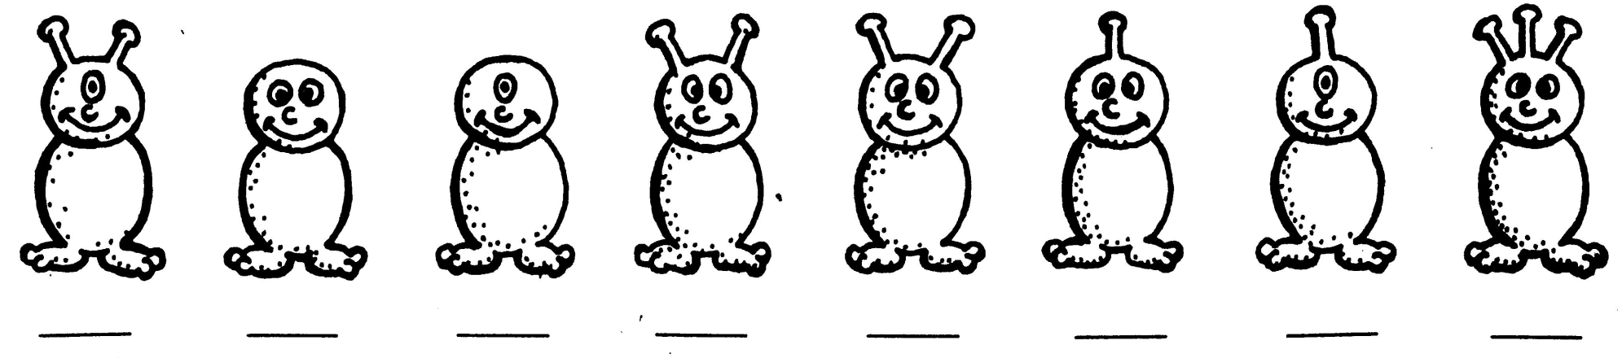
How to use a Dichotomous Key?
Here are creatures we don’t know!
Lets choose one
Notes:
22

Slide 23
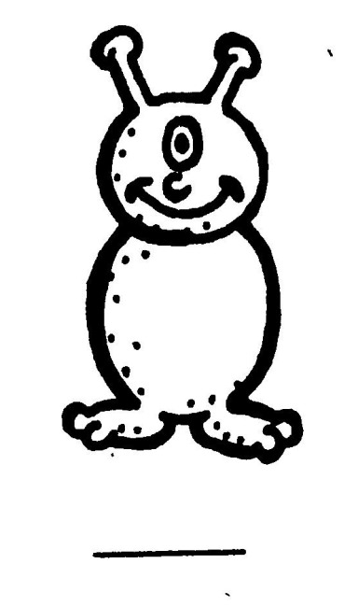

How to use a Dichotomous Key?
Choose only one creature at a time.
Notes:
23

Slide 24


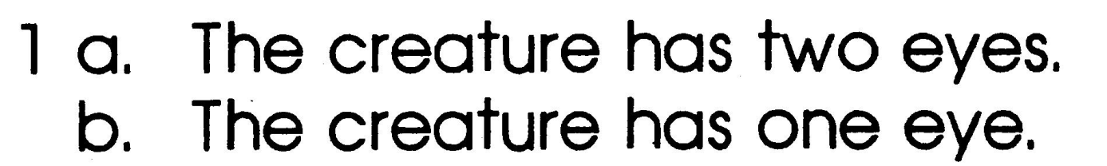
How to use a Dichotomous Key?
Read steps 1a and 1b
Decide which statement is true
1b is true

Slide 25
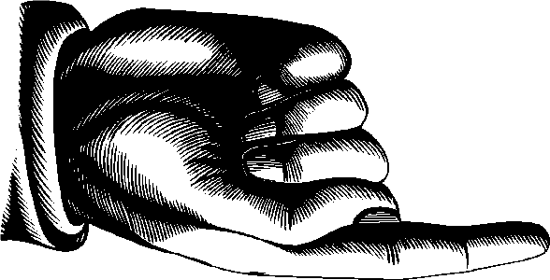
How to use a Dichotomous Key?
Then follow the directions after that step.
Go to step 5!

Slide 26
How to use a Dichotomous Key?
At choice 5, you make another dichotomous choice
5a is true
Go to step 6!

Slide 27
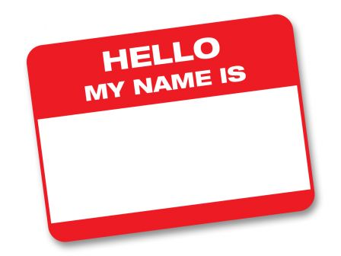
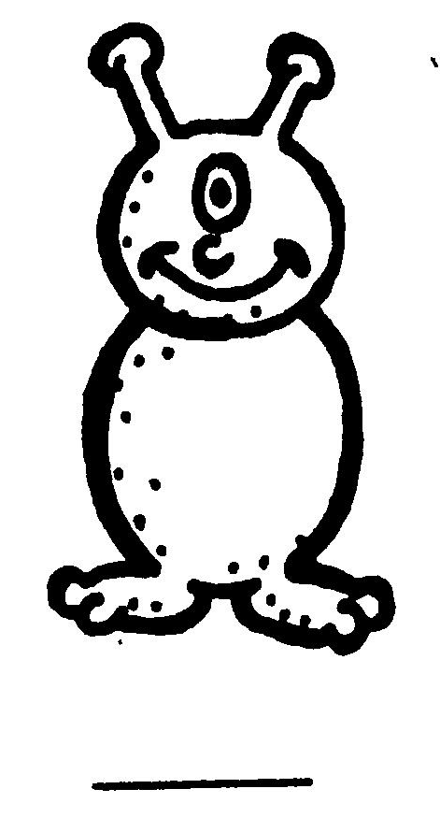
How to use a Dichotomous Key?
Keep going until you come to a step
that gives you the creature’s name.
6 a. The creature has one antennae Go to Step 7.
C

Slide 28

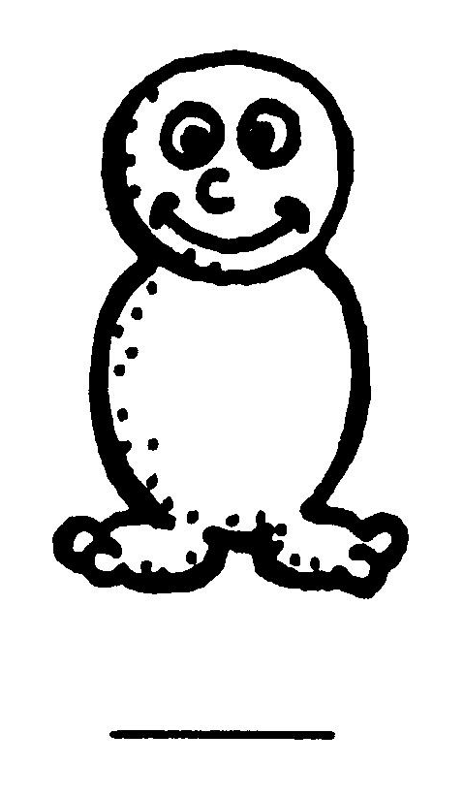
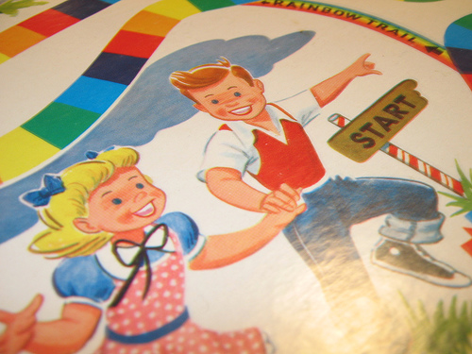
How to use a Dichotomous Key?
Choose a new creature and start at step 1a and 1b again. Continue until you find the creature’s name.
C
Where do you start Again?

